Slide 1
HIV Screening &STI Syndromic Case Management-An Overview
Dr. Ingudum Lalit
Medical Advisor, PATH

Slide 2
Historical Overview of HCT under NACP
NACP Phase | Services
I | HIV counselling and Testing Services started in 1997
II | Treatment services started in 2004
III | HCT outreach services and mobile ICTC in 2007
IV | Program scale up through Facility based screening services (Decentralisation of testing sites)
V | Test and Treat Policy
Source: National HIV Counselling and Testing Guideline, 2024

Slide 3
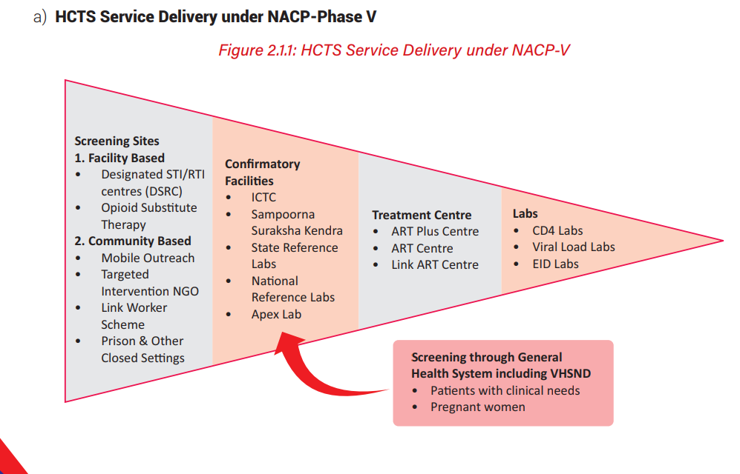
HCTS Delivery under NACP-Phase V
All the screening sites will be linked to the nodal ICTC

Slide 4
HIV Screening and HIV Confirmation Test
HIV Screening Test:
Rapid test, result within 20-30 minutes
Initial testing to detect the presence of HIV antibodies or HIV antigen in a person
Reported as “Reactive or Non-Reactive”
Confirmatory Test:
Sequential testing to rule out false positive results from screening test and provide definitive outcome.
Screened HIV reactive clients will be linked to the nearest confirmatory ICTC where they will be provided services for confirmation of HIV diagnosis

Slide 5
Priority population for HCTS include the following:
1. High-risk Group Populations including Prisons and other closed settings (P&OCS)
2. Self-walk-in clients at ICTC with risk behaviour
3. Social and sexual networks of self-initiated clients / individuals
4. HIV negative partners of PLHIV Index case including partners with unknown HIV status
5. Clients motivated from National AIDS helpline 1097/ IEC material/ virtual outreach, etc.
6. At-risk youth and adolescents
7. STI/RTI clients
8. Individuals in casual sexual relation with regular/non-regular partner/s
9. Screened reactive referrals for confirmatory test and screened reactive from Blood Centres
10. Provider initiated referral with high index of clinical suspicion for HIV and AIDS
11. Social network Partner/s of high-risk and at -risk population
12. HIV Exposed babies 13. Pregnant Women

Slide 6
Package of services at HIV/Syphilis Screening Sites
• Pre and post-test counselling, obtaining informed consent, conducting risk assessment
• HIV screening, referral of HIV screened reactive cases to confirmatory facility and sharing of test result, disclosure while maintaining confidentiality.
• Syphilis screening and sharing of test result
• Screening for STI/RTI, TB and other co- infections
• Linkage for HIV confirmation to ICTC
• Linkage to DSRC for treatment of syphilis/STI
• Referral to TI NGO, LWS, Sampoorna Suraksha Kendra, or other health facilities as per the need
• Demonstration, distribution and availability of condoms and
• Display of the relevant IEC material for HIV and STI

Slide 7
10S Screening
Cough
Fever
Night Sweet
Weight Loss
Chest Pain
Shortness of Breath
Loss of appetite
Fatigue
Swelling in neck
Hemoptysis

Slide 8
Approaches for Community Based Screening
Community based screening is available under the National AIDS & STD Control Program as well as under the larger umbrella of General Health System to improve HCTS access and coverage. Various approaches are :
Community Based Camps or Outreach activity
(2) Outreach through Mobile Vans or Motor Bikes
(3) Mobile Medical Units/ Outreach Camps
(4) Screening by Ancillary health-care providers, such as at VHSND
(5) Screening by Targeted Interventions projects, Link Worker Schemes/ Opioid Substitution Therapy Centres under NACP
(6) HIV screening for Prison inmates and clients in Other Closed Settings
(7) HIV screening at the workplace

Slide 9
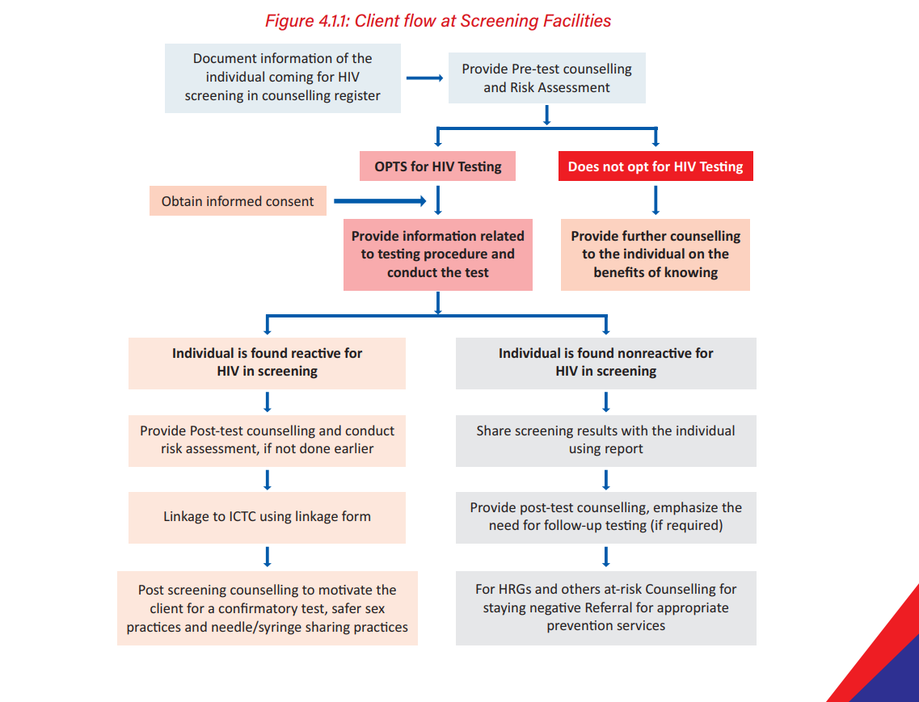
Client Flow at Screening Facilities

Slide 10
Pre-Test Counselling and Post-Test Counselling at Screening Facilities
Pre-Test Counselling: Done by
prescribing physicians or
any paramedical staff designated for HIV screening (e.g. PHN/ LHV/ANM/MPW male/pharmacist/LT /ORW/SN /ASHA or
any other trained paramedical staff), shall provide pre-test counselling for all provider referred clients
Post Test Counselling:
Any trained paramedical staff designated for HIV screening in the health facility should provide the post-test counselling
WHY POST TEST COUNSELLING?
Post-test counselling helps the individual to understand and cope with the HIV test result.
WHEN SHOULD POST TEST COUNSELLING BE DONE?
All efforts must be made to provide test results on the same day and post-test counselling to all those accessing HIV services at the HCTS facilities
WHO SHOULD BE COUNSELLED?
All HIV reactive/ indeterminate/ positive at ICTC
Whenever risk has been elicited irrespective of whether the result is HIV non-reactive/reactive at screening facility

Slide 11
Content Of Pre-Test Counselling
Provide information on HIV and AIDS: what is HIV, what is AIDS, window period, route of transmission, prevention message, care, support and treatment services
Explain the benefits of HIV testing and risk assessment
Assure the individual that the test result and any information shared will be kept confidential
Explain that the individual has the right to opt out of HIV testing and this will not affect their access to any other health-related services
Implication of a positive test result, including availability of free treatment at government hospitals and identified private hospitals
Implications of a negative test result including preventive services
Disclosure if positive
Provide information on importance of Index Testing Services (spouse/sexual/injecting partner/ biological children testing) with consent and confidentiality.
Provide information on genital, menstrual and sexual hygiene
Demonstrate the use of a condom using any IEC material e.g. penis model, etc.
Extend the opportunity to the individual to ask and clarify doubts related to HIV and AIDS, if any

Slide 12
Content Of Pre-Test Counselling Contd.
Provide customized services for clients accessing HCTS services through virtual interventions
In addition, explain to all pregnant and breastfeeding women regarding EVTHS
Additional counselling of patient who has declined the test:
• That they can return at any time for further information and or testing
• Other health facilities that can offer HIV counselling and testing services
• Information that can be used in prevention and risk reduction for that individual
• That declining the test does not affect any other health service provision

Slide 13
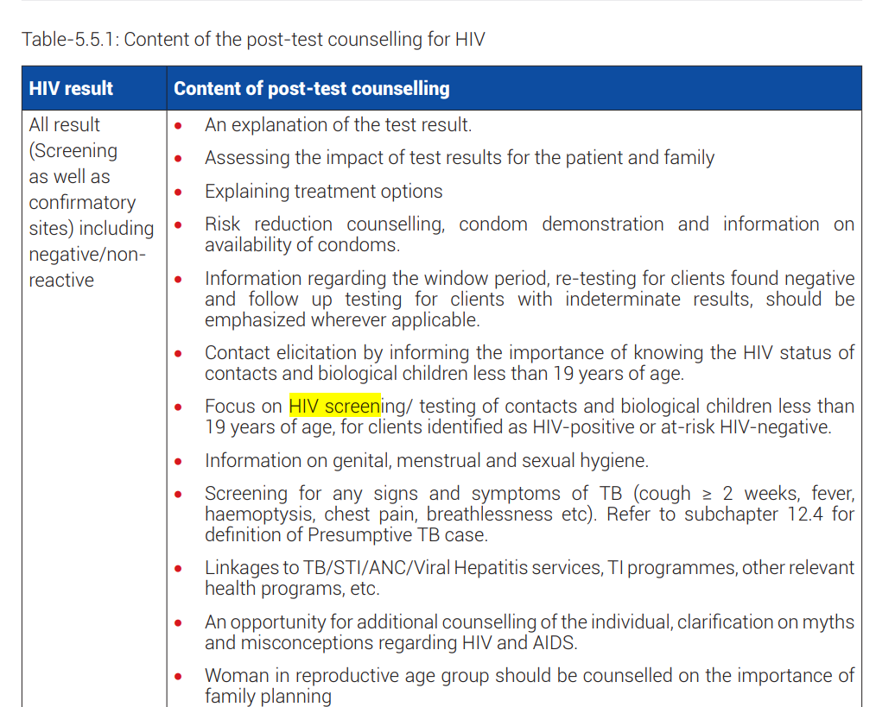
Content of Post Test Counselling
The Guidelines issued in July 2022 on the HIV and AIDS (Prevention and Control) Act 2017, provides guidance on Post Test Counselling for HIV and is detailed below

Slide 14
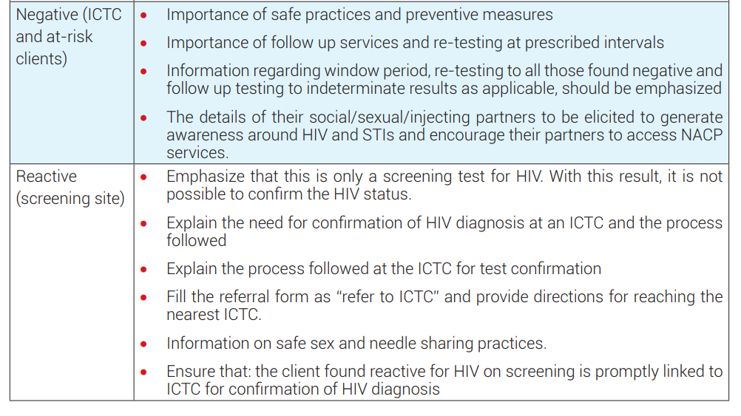
Content for Post Test Counselling

Slide 15
Index Testing Services
What are index testing services?
Index testing service (ITS), or partner notification service
Voluntary case-finding approach
Trained service providers (with the consent of the HIV-positive client), focus on elicitation of sexual and needle sharing contacts and biological children (less than 19 years of age) of the client, and offer them HIV counselling and testing services.
Index Client: All newly diagnosed PLHIV, as well as known PLHIV are the index clients under the Index Testing Services.

Slide 16
Index Testing Contd.
Contact:
Sexual contacts should include ALL persons who have had sex with the Index client (even if it was just a single encounter and even if they have always used condoms).
Needle sharing contacts including ALL persons who have shared needles, syringes or injection equipment with the Index client (even if it was just one time and even if they cleaned the needle, syringes or injection equipment before sharing).
Contact elicitation should start with the most recent exposure and go backwards in time as far as possible, as per the recall capacity of the index client
For Index clients who are children ( less than 19 years of age) the contacts will include:
• Biological mother
• Biological father, if the child’s mother is HIV-positive, deceased, or her status is unknown.
• Biological sibling/s
• Sexual and needle sharing contacts, if elicited during the history taking

Slide 17
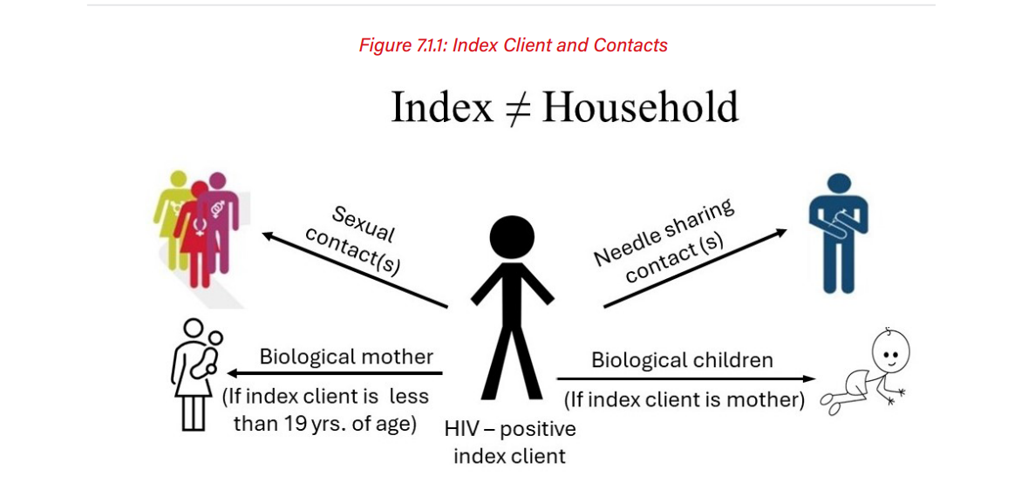
Index Testing Services Contd.

Slide 18
SYNDROMIC MANAGEMENT OF STI

Slide 19




Concentrated Epidemic among Key Risk Groups
High risk groups
(FSW, MSM, IDU, TG)
Bridge Population
(Migrant workers & Truckers)
General Population
(Low risk Men & Women)
New born Children
FSW: Female Sex Workers; MSM: Men who have sex with Men; IDU: Injecting Drug Users; TG: Transgender
3

Slide 20
STI/HIV Inter-relationships
Behavioral
Both are sexually transmitted
Epidemiological
Populations with high rates of STIs show disproportionally high rates of sexually-transmitted HIV
Immunological
STIs facilitate sexual HIV acquisition & transmission
4
Notes:
References
CDC. STDs and HIV – CDC Fact Sheet (2015) www.cdc.gov/std/hiv (accessed 3/9/2015)
Cohen, MS. (2014). STDs amplify transmission of HIV: Where do WE go from here?. Webinar – CDC STD Prevention Science Series, presented 12/11/14. www.cdc.gov/std/training/webinars.
Cohen, MS & Pilcher, CD. (2005). Amplified HIV transmission and new approaches to HIV prevention. The Journal of Infectious Diseases, 191, p 1391–3.
Hitchcock, PJ. (1996). Screening and treatment of sexually transmitted diseases: an important strategy for reducing the risk of HIV transmission. AIDS PATIENT CARE and STDs, 10 (3), p 10-15.
Royce, RA, Sena, A, Cates, W, Cohen, MS. (1997). Sexual transmission of HIV. New England Journal of Medicine, 336 (15), p 1072-78.
Rothenberg, RB, Wasserheit, JN, St Louis, ME, Douglas, JM, and the ad hoc STD/HIV Transmission Group. (2000). The effect of treating sexually transmitted diseases on the transmission of HIV in dually infected person. STD, 27 (7), p 411-16.
Sullivan, AK, Atkins, MC, Boag, F. (1997). Factors facilitating the sexual transmission of HIV-1. AIDS PATIENT CARE and STDs, 11 (3), p 167-77.
St Luis, ME, Wasserheit, JN, Gayle, HD. (1997). Editorial: Janus considers the HIV pandemic – harnessing recent advances to enhance AIDS prevention. American Journal of Public Health, 87 (1), p 10-12.
Wasserheit, JN. (1992). Epidemiological synergy Interrelationships between human immunodeficiency virus infection and other sexually transmitted diseases. Sexually Transmitted Diseases, 19 (2), p 61-77.

Slide 21
Relationship Between STIs And HIV (Cofactor Effects on HIV Transmission)
HIV infection is predominantly sexually transmitted in India (94%)
STIs amplify HIV transmission
Presence of STIs increases risk of HIV transmission:
Loss of epithelial integrity
Recruitment & activation of inflammatory cells
Immune dysregulation
STIs in HIV-positive people can increase viral load
A higher viral load increases HIV transmission risk to others

Slide 22
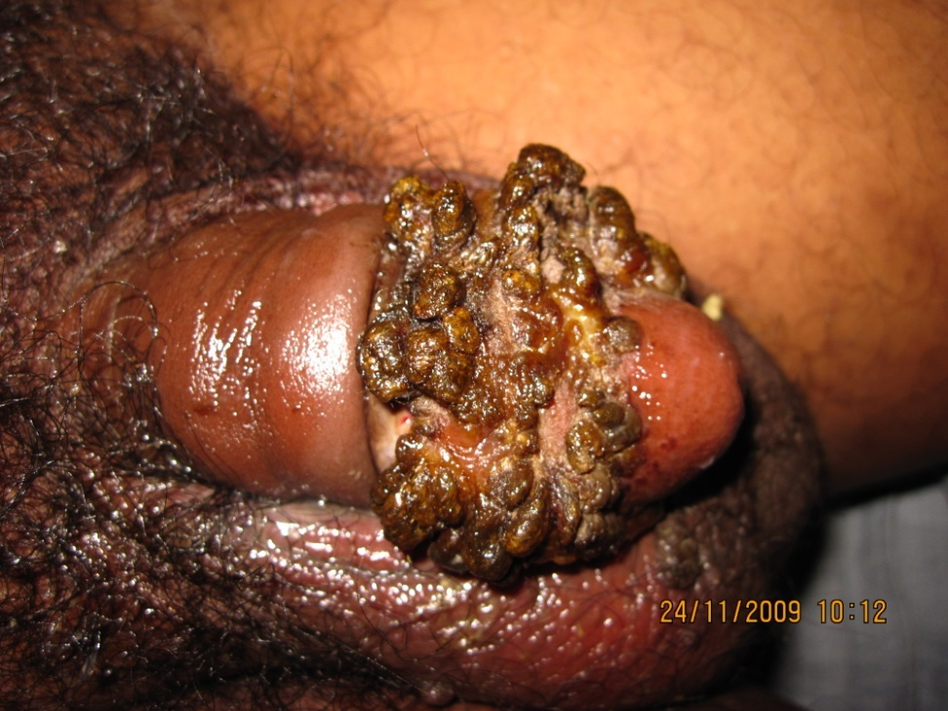
STIs Management Approaches
Aetiological
Clinical Diagnosis
Syndromic
Presumptive
Images Courtesy:
CoE, Bowring & Lady Curzon Hospital, Bengaluru
20
Notes:
Trainer Notes:
Ask participants to take a moment and think of the advantages and disadvantages of the different approaches
Discuss the different approaches in the management of STIs.
There are four management approaches in the management of STIs that are applicable at individual, group and community level.
1. Aetiologic Approach:
The aetiologic approach stresses identifying causative organism and treating the specific aetiology identified. Problems with this approach include:
The need for expensive laboratory support (dark field microscopy)
The need for sophisticated tests (e.g., Chlamydia)
The delay in initiation of treatment of cases until the results return
Loss of follow up of cases
Interpretation of results may be difficult (Quality control of results and testing procedures needs to be an ongoing process)
Partner treatment is difficult to ensure.
2. Clinical Approach:
The clinical approach focuses on the clinical experience of the treating physician, who relies on specificity of clinical manifestations and appearance of lesions to make a diagnosis.
Studies have documented the unreliability of clinical diagnosis to provide STI treatment.
In studies done abroad, only 30% of patients with chancroid and 10% of patients with mixed infections were identified correctly.
3. Syndromic Approach:
The syndromic approach gives treatment to all possible STIs that cause the syndrome based on epidemiological and laboratory data. This is a simple, easy to follow method, which can be practiced by community health workers.
Patients are treated at the first visit
Minimal equipment/lab support is necessary
It is effective in the presence of mixed infections.
Presence of STI complications or conditions not included within flowchart algorithms necessitate referral to STI specialists for individual assessment and correct treatment.
4. Presumptive Approach:
The presumptive approach aims to treat asymptomatic STIs within high risk groups.
Presumptive approach treats all prevalent STIs in the community at the time of first visit, irrespective of whether patients are symptomatic or not. Single dose therapy is given. The risk of dissemination of resistance within the community needs to be considered.
From a public health perspective, interventions which benefit the group and community level are essential for controlling STIs.

Slide 23
Syndromic Management
Medical treatment
Follow-up: Return in 7 days, if symptoms persist
Partner notification
Rule out other STIs
Voluntary HIV test and counselling
Counselling & education
Safe sex
Risk reduction
Behaviour modification
Condom promotion and provision
23
Notes:
Step 3: Syndromic Management (Slides 23-34)-20 minutes
Trainer Notes:
The trainer may explain the components of the syndromic management by using the points on the slide.
Because of the advantages of the syndromic management approach, it is the first choice in the management of STIs even at the individual level. This also leads to community level benefits, as we shall see subsequently.
Syndromic management is not only about giving medical treatment to individual patients, but is a comprehensive set of measures which help to control STIs.

Slide 24
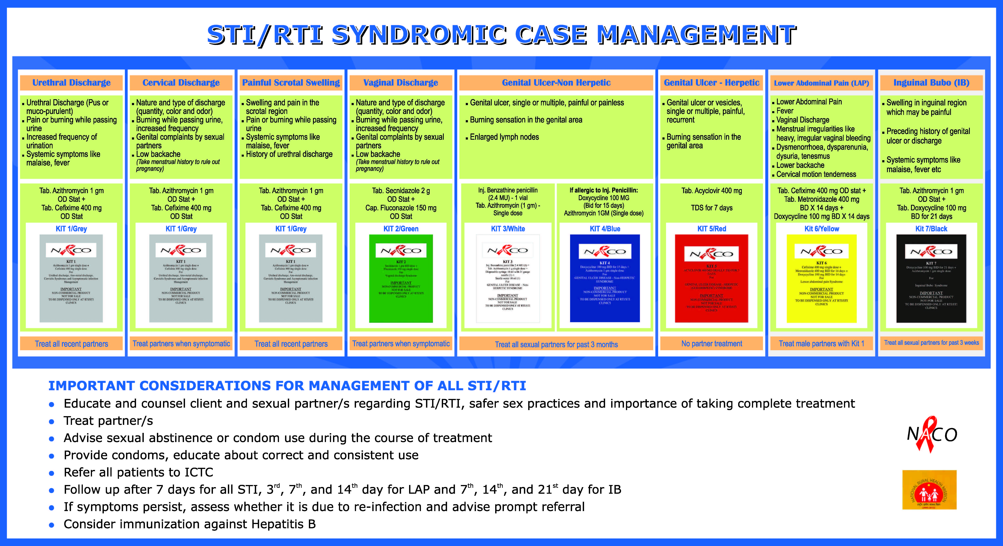
Syndromes
Syndromic approach uses flow charts to identify causes of 7 common syndromes associated with STIs:
Urethral discharge / Burning micturition
Genital ulcer
Vaginal discharge
Scrotal swelling
Lower abdominal pain
Inguinal bubo
Oral and Anal STIs
24
Notes:
Trainer Notes:
List out the syndromes. This is the latest revised syndromic flow chart which is more specific.

Slide 25
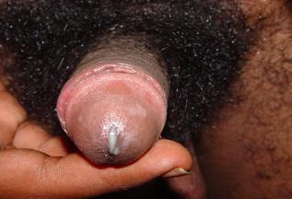
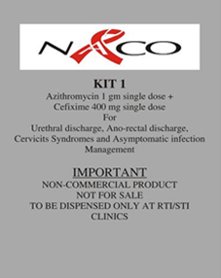
Urethral Discharge
Complications
Epididymitis
Periurethral abscess
Urethral stricture
Prostatitis
Gonococcal arthritis
Treatment:
Tab. Azithromycin 1g od, single dose +
Tab. Cefixime 400 mg od, single dose
25
Notes:
Trainer Notes:
Present a brief history to correlate with the clinical findings in the above image
A 25 year old male presented with history of unprotected sex a week before presenting with complaints of purulent urethral discharge.
Ask the participants how to approach the above patient.
Answer: This is urethral discharge syndrome. Since there is visible purulent discharge, treat for Gonorrhoea and Chlamydia as per the treatment chart.

Slide 26
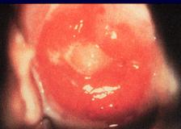
Cervical Discharge Syndrome (Cervicitis)
Yellowish discharge with bad odour
Nature and type of discharge: quantity, colour, odour
Burning while passing urine, increased frequency
Treatment:
Tab. Azithromycin 1g od, single dose +
Tab. Cefixime 400 mg od, single dose
26
Notes:
Trainer Notes:
Ask participants: “Enumerate the aetiologies for endocervical discharge?“
Answer:
Cervicitis is caused by N.gonorhoeae and C.trachomatis while Trichomonas, Candida and Bacterial Vaginosis cause vaginitis. Clinical differentiation between the two is difficult.
An assessment of the risk status will help in making a diagnosis.
Risk factors associated with cervical infection include:
Younger than 21 years
Not married
Multiple (more than one) sex partners in the last three months
A new partner in the last three months
Current sex partner has a sexually transmitted infection
Recent use of condoms by the partner

Slide 27

Painful Scrotal Swelling
Swelling and pain in the scrotal swelling
Pain or burning while passing urine
Systemic symptoms like malaise, fever
History of urethral discharge
Treatment:
Tab. Azithromycin 1g od, single dose +
Tab. Cefixime 400 mg od, single dose
27
Notes:
Trainer Notes:
Ask participants, if a patient presents with pain and swelling in the scrotum, how would you manage?
Answer:
The possible aetiological agents would be gonorrhoea and Chlamydia. Treat for both the infections.
The other differential diagnosis that can be thought of the following :
Infectious causes of Scrotal swelling:
Tuberculosis, filariasis, coliforms, pseudomonas, mumps infection.
Non infectious causes:
Trauma, Hernia, Hydrocoele, Testicular torsion, and Testicular tumors.

Slide 28
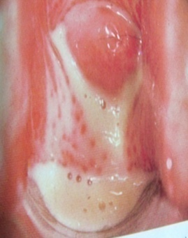
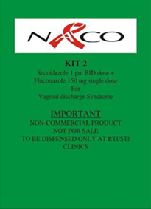
Vaginal Discharge Syndrome
Vaginal discharge- cheese white
Nature and type of discharge: quantity, colour, odour
Itching around genitalia
Treatment:
Tab. Secnidazole 2g OD, single dose +
Tab. Fluconazole 150 mg OD, single dose
28
Notes:
Trainer Notes:
Discuss the common causes of vaginal discharge and present the management approach.

Slide 29
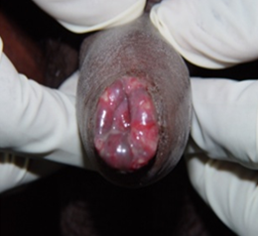
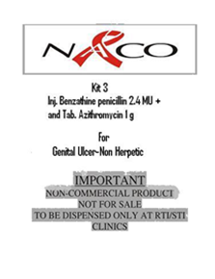
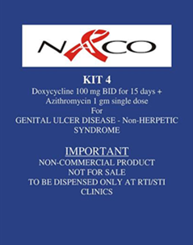
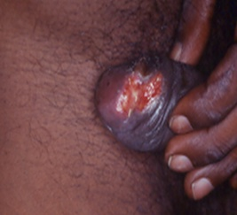
Genital ulcer: Non Herpetic
Genital Ulcer; single or multiple; painful or painless
Burning sensation in the genital area
Burning sensation in the genital area
Enlarged lymph
Treatment:
Inj. Benzathine Penicillin 2.4 MU +
Tab. Azithromycin 1gm od, single dose (OR)
Doxycycline 100 mg bid X 15 days + Tab. Azithromycin 1g od, single dose
29
Notes:
Trainer Notes:
Ask participants: “Enumerate the aetiologies for a genital ulcer?” Discuss this slide and the next slide together
Answer:
Genital ulcer is caused by T.Pallidum (syphilis), Herpes Simplex (Genital Herpes), Haemophilus Ducreyi (Chancroid), K.Granulamatis (Granuloma inguinale), Chlamydia trachomatis (Lymphogranuloma venerum).
An assessment of the risk status will help in making a diagnosis.
Syphilitic chancre is usually a single painless ulcer with induration though atypical presentations are common in HIV. Multiple chancres may be present. Onset of lesion is after a sexual exposure.
If there is no suspicion of herpes, then the treatment should cover for syphilis and chancroid.
On review after a week, if the lesion persists, the patient should be referred.
Herpetic ulcers are usually painful and multiple. The lesions as small vesicles and which break down to form erosions or ulcers.

Slide 30
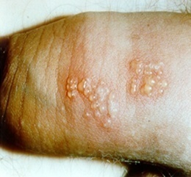
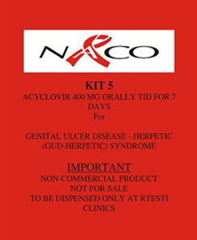
Genital ulcer: Herpetic
Eruption of vesicles, painful, multiple genital ulcer
Burning sensation in the genital area
Recurrence
Treatment:
Tab. Acyclovir 400 mg tds X 7 days
30
Notes:
Trainer Notes:
Ask the participants “ How to differentiate syphilitic ulcer and a herpetic ulcer”
Answer:
Syphilitic chancre is usually a single painless ulcer with induration though atypical presentations are common in HIV. Multiple chancres may be present. Onset of lesion is after a sexual exposure.
Herpetic ulcers are usually painful and multiple. The lesions as small vesicles and which break down to form erosions or ulcers.
In a patient presenting with a genital ulcer, after confirming that the patient has an ulcer, evidence of vesicles either now, or in the past, should be sought for.
If vesicles are noted, then the patient should be treated for herpes, with Acyclovir 400 mg 3 times a day for a week.
Partner treatment should be given to those with genital ulcers other than herpes.
The partners of those with herpes should be examined and treated only if symptomatic.

Slide 31
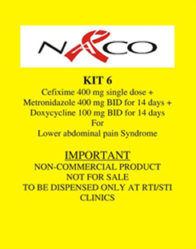
Lower Abdominal Pain
Lower Abdominal Pain
Fever
Vaginal discharge
Menstrual irregularities like heavy, irregular vaginal bleeding
Dysmenorrhoea, dysparenunia, dysuria, tenesmus
Lower backache
Cervical motion tenderness
Treatment:
Tab. Cefixime 400 mg od single dose +
Tab. Metronidazole 400 mg bid X 14 days +
Tab. Doxycycline 100 mg bid X 14 days
31
Notes:
Trainer Notes:
Discuss the common causes of lower abdominal pain in women and present the syndromic management approach.

Slide 32
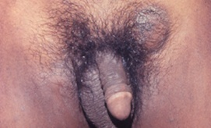
Inguinal Bubo
Swelling in inguinal region, which may be painful
Preceding history of genital ulcer or discharge
Systemic symptoms like malaise, fever
KIT 7
Black
Treatment:
Doxycycline 100 mg bid X 21 days +
Tab. Azithromycin 1g single dose
32
Notes:
Trainer Notes:
Discuss the common causes of Inguinal Bubo and present the syndromic management approach.

Slide 33
Syndromic management: Advantages
Fast, the patient is diagnosed and treated in one visit
Relatively inexpensive
No need for patient to wait for lab results
All possible STIs causing common symptoms and signs are treated
Scientifically proven strategy in many parts of the world
Easy to learn and practice by health care workers
Easily added into primary health care services
Can be implemented by HCP at all levels of Health Care
Facilitates standardisation of treatment regimens
33

Slide 34
Syndromic management: Limitations
Not useful in asymptomatic individuals
Over-treatment
Cost of over-treatment & side-effects
Potential for antibiotic resistance development
Poor sensitivity / specificity
34

Slide 35
THANK YOU

